Slide 1
DSA 503
NONPARAMETRIC TESTS

Slide 2

THE SIGN TEST
Tests About Categorical Data

Slide 3
THE SIGN TEST
Definition
The sign test is used to make hypothesis tests about preferences, a single median, and the median of paired differences for two dependent populations. We use only plus and minus signs to perform these tests.

Slide 4
(a) Tests About Categorical Data
Data that are divided into different categories for identification purposes are called categorical data
The Small-Sample Case
  When we apply the sign test for categorical data, if the sample size is 25 or less (i.e., n ≤ 25), we consider it a small sample.

Slide 5
Example 15-1
The Top Taste Water Company produces and distributes Top Taste bottled water. The company wants to determine whether customers have a higher preference for its bottled water than for its main competitor, Spring Hill bottled water.
The Top Taste Water Company hired a statistician to conduct this study. The statistician selected a random sample of 10 people and asked each of them to taste one sample of each of the two brands of water.

Slide 6
Example 15-1
The customers did not know the brand of each water sample. Also, the order in which each person tasted the two brands of water was determined randomly. Each person was asked to indicate which of the two samples of water he or she preferred. The following table shows the preferences of these 10 individuals.

Slide 7
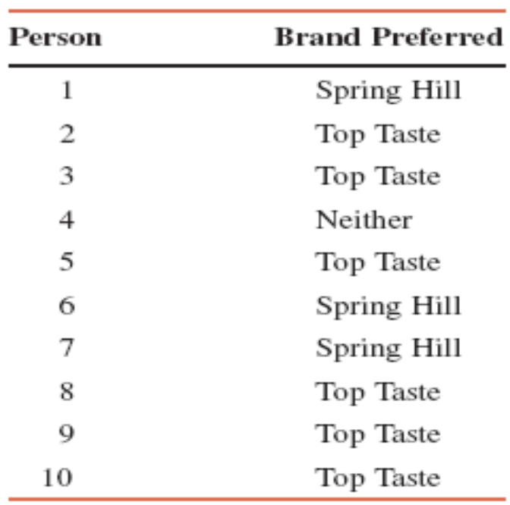
Example 15-1

Slide 8
Example 15-1
Based on these results, can the statistician conclude that people prefer one brand of bottled water over the other? Use the significance level of 5%.

Slide 9
Example 15-1: Solution
Step 1:
H₀: p = .50 (People do not prefer either of the two brands of water)
H₁: p ≠ .50 (People prefer one brand of water over the other)

Slide 10
Example 15-1: Solution
Step 2. Distribution:
Binomial
Note: We drop the members who do not indicate a preference and then compare the preferences of the remaining members

Slide 11
Example 15-1: Solution
There are three outcomes for each person:
  Prefers Top Taste water
  Prefers Spring Hill water
  Has no preference
We are to compare the two outcomes with preferences and determine whether more people belong to one of these two outcomes than to the other

Slide 12
Example 15-1: Solution
Step 3:Critical value and regions
True sample size n = 9
α = .05 and the test is two-tailed
From Sign Table VIII,
for n = 9 and α = .05, the critical values of X are 1 and 8

Slide 13
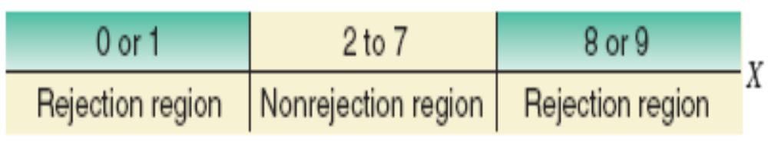
Figure 15.1

Slide 14
Critical Value(s) of X
In a sign test of a small sample, the critical value of X is obtained from Table VIII. If the test is two-tailed, we read both the lower the upper critical values from that table. However, we read only the lower critical value if the test is left-tailed, and only the upper critical value if the test is right-tailed. Also note that which column we use to obtain this critical value depends on the given significance level and on whether the test is two-tailed or one-tailed.

Slide 15
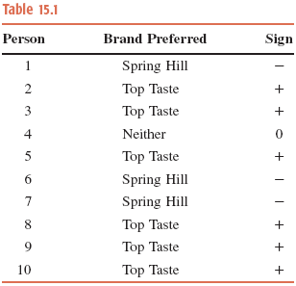
Table 15.1
Step 4: Let X be the number of people in the sample of 9 who prefer Top Taste bottled water
X is called the test statistic

Slide 16
Observed Value of X
The observed value of X is given by the number of signs that belong to the category whose proportion we are testing for.

Slide 17
Example 15-1: Solution
Step 5:
The observed value of X = 6
  It falls in the non-rejection region
Therefore, we fail to reject H₀
Step 6: Conclusion:
Hence, we conclude that our sample does not indicate that people prefer either of these two brands of bottled water over the other

Slide 18

THE WILCOXON SIGNED-RANK TEST FOR TWO DEPENDENT SAMPLES
The Wilcoxon signed-rank test for two dependent (paired) samples is used to test whether or not the two populations from which these samples are drawn are identical. We can also test the alternative hypothesis that one population distribution lies to the left or to the right of the other.

Slide 19
THE WILCOXON SIGNED-RANK TEST FOR TWO DEPENDENT SAMPLES
The Small-Sample Case
If the sample size is 15 or smaller, we find the critical value of the test statistic, T, from Table IX which gives the critical value of T for the Wilcoxon signed-rank test. However, when n > 15, we use the normal distribution to perform the test.

Slide 20
Example 15-7
A private agency claims that the crash course it offers significantly increases the writing speed of secretaries. The following table gives the writing speeds of eight secretaries before and after they attended this course.

Slide 21
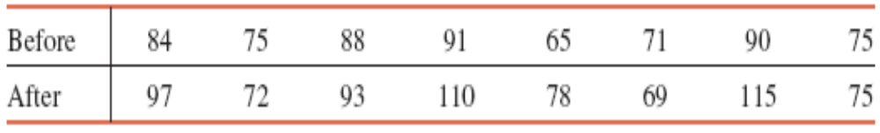
Example 15-7
Using the 2.5% significance level, can you conclude that attending this course increases the writing speed of secretaries? Use the Wilcoxon signed-rank test.

Slide 22
Example 15-7: Solution
Step 1:
H₀: M_{A} = M_{B} (The crash course does not increase the writing speed of secretaries)
H₁: M_{A} > M_{B} (The crash course does increase the writing speed of secretaries)

Slide 23
Example 15-7: Solution
Step 2: Distribution:
Unknown

Slide 24
Example 15-7: Solution
Step 3. Critical value and regions:
α = .025
n = 7
Note that for one pair of data, both values are the same, 75. We drop such cases when determining the sample size for the test.
The test is right-tailed.
From Table IX, the critical value of T = 2

Slide 25

Figure 15.7

Slide 26
Decision Rule
For the Wilcoxon signed-rank test for small samples (n ≤ 15), the critical value of T is obtained from Table IX. Note that in the Wilcoxon signed-rank test, the decision rule is to reject the null hypothesis if the observed value of T is less than or equal to the critical value of T. This rule is true for a two-tailed, a right-tailed, or a left-tailed test.

Slide 27
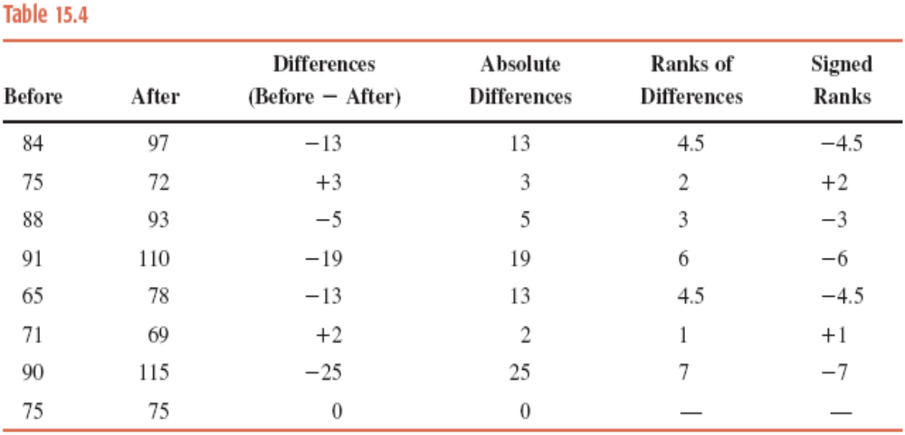
Example 15-7: Solution
Step 4: Test statistic

Slide 28
Observed Value of the Test Statistic T
If the test is two-tailed with the alternative hypothesis that the two distributions are not the same, then the observed value of T is given by the smaller of the two sums, the sum of the positive ranks and the sum of the absolute values of the negative ranks. We will reject H₀ if the observed value of T is less than or equal to the critical value of T.

Slide 29
Observed Value of the Test Statistic T
If the test is right-tailed with the alternative hypothesis that the distribution of after values is to the right of the distribution of before values, then the observed value of T is given by the sum of the values of the positive ranks. We will reject H₀ if the observed value of T is less than or equal to the critical value of T.

Slide 30
Observed Value of the Test Statistic T
If the test is left-tailed with the alternative hypothesis that the distribution of after values is to the left of the distribution of before values, then the observed value of T is given by the sum of the absolute values of the negative ranks. We will reject H₀ if the observed value of T is less than or equal to the critical value of T.

Slide 31
Observed Value of the Test Statistic T
Remember, for the above to be true, the paired difference is defined as the before value minus the after value. In other words, the differences are obtained by subtracting the after values from the before values.

Slide 32
Example 15-7: Solution
Step 4:
Observed value of T
= sum of the positive ranks = 3

Slide 33
Example 15-7: Solution
Step 5. Decision:
Whether the test is two-tailed, left-tailed, or right-tailed, we will reject the null hypothesis if ‘Observed value of T ≤ Critical value of T’
Hence, we do not reject H_{0.}
Step 6. Conclusion:
We conclude that the crash course does not seem to increase the writing speed of secretaries.
…………………………………

